Slide 1
Prof Omer Maaitah
6 Management meeting
Online

Slide 2
See attached report
Training from August until March

Slide 3
See attached report
Stakeholder Meeting

Slide 4
Report about achievement from each partner is required

Slide 5
Networking and Associated partner is needed

Slide 6
Thank You

Slide 7
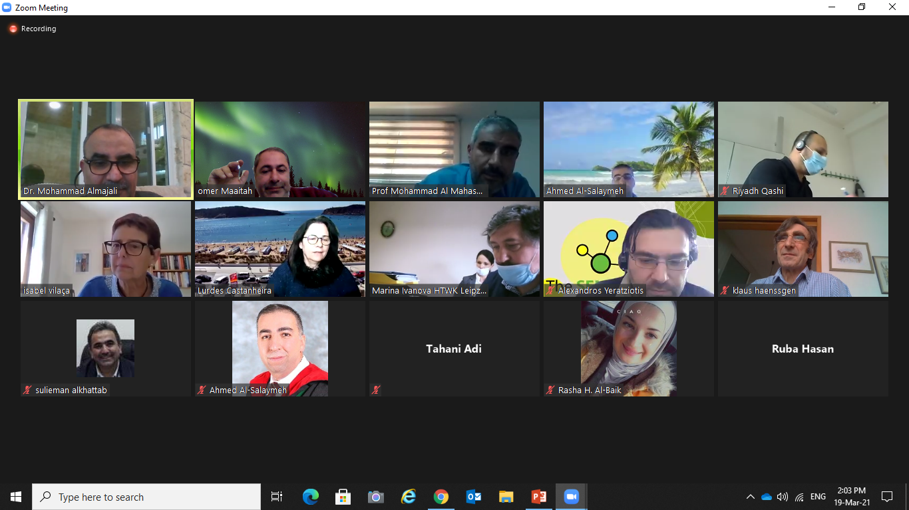

Slide 8
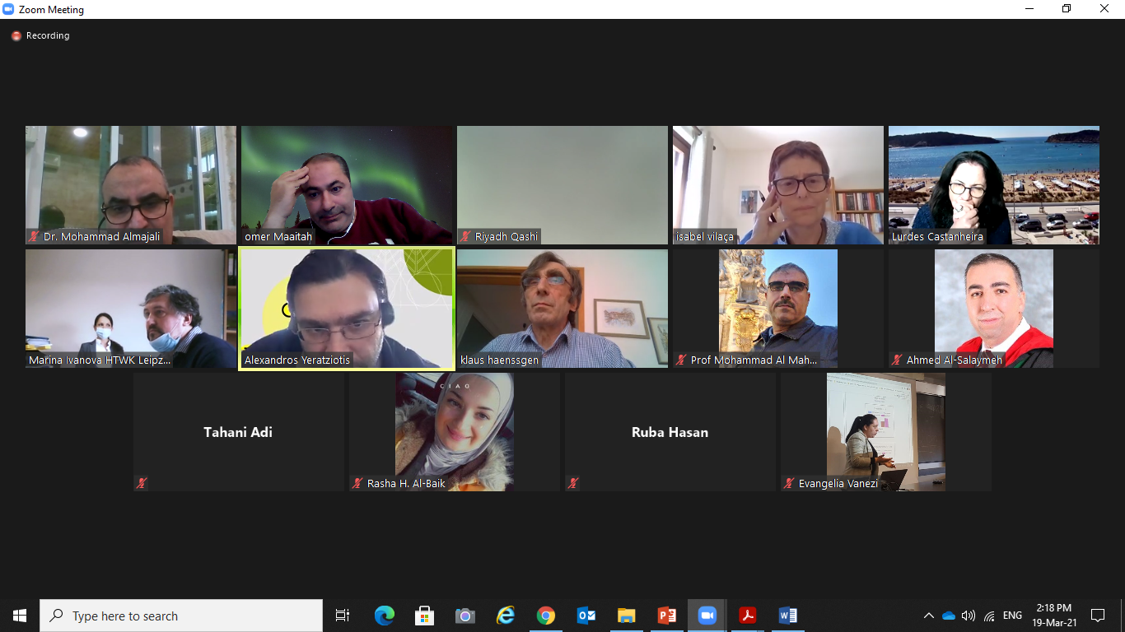

Slide 9
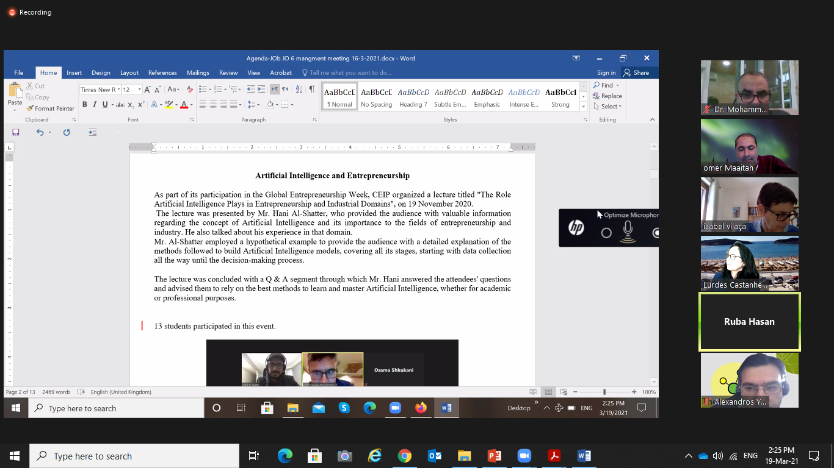

Slide 11
